Slide 1


Social Buzz Content Analysis

Slide 2


Today's agenda
Project recap
Problem
The Analytics team
Process
Insights
Summary

Slide 3

Social Buzz a fast growing social media company, has hired Accenture to enable them handle the demands of their rapid expansion.
The key deliverables of an initial 3 month project include:
An audit of their big data practice
Recommendations for a successful IPO
An analysis of their content categories that highlights the top 5 categories with the largest aggregate popularity
Project Recap

Slide 4

Problem
Over 12.6m daily reactions
Need to makes sense of all these data
Content analysis to identify the top 5 most popular categories

Slide 5



Andrew Fleming
(Chief Technical Architect)
The Analytics team
Marcus Rompton
(Senior Principal)
Adenugba Oluwajuwon
(Data Analyst)

Slide 6
Identification of requirements
Process
1
Data extraction
2
Data cleaning and modeling
3
Data analysis
4
5
Data Visualization

Slide 7

Insights
16
Content
Categories
1897
Reactions to Animal Posts
February
has least number of reactions

Slide 8
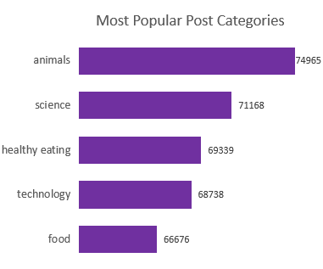

Slide 9
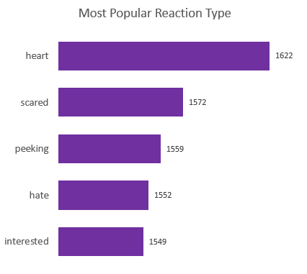

Slide 10

INSIGHTS
Animal category might overshadow others.
Audience’s potential health consciousness.
Potential interest in educational content.
Further analysis to address popular negative reactions
Engagement campaigns to address low reaction months
WHAT’S NEXT
More comprehensive real-time analysis to improve company wide efficiency and performance.
Summary

Slide 11
Thank you!
ANY QUESTIONS?

